Slide 1
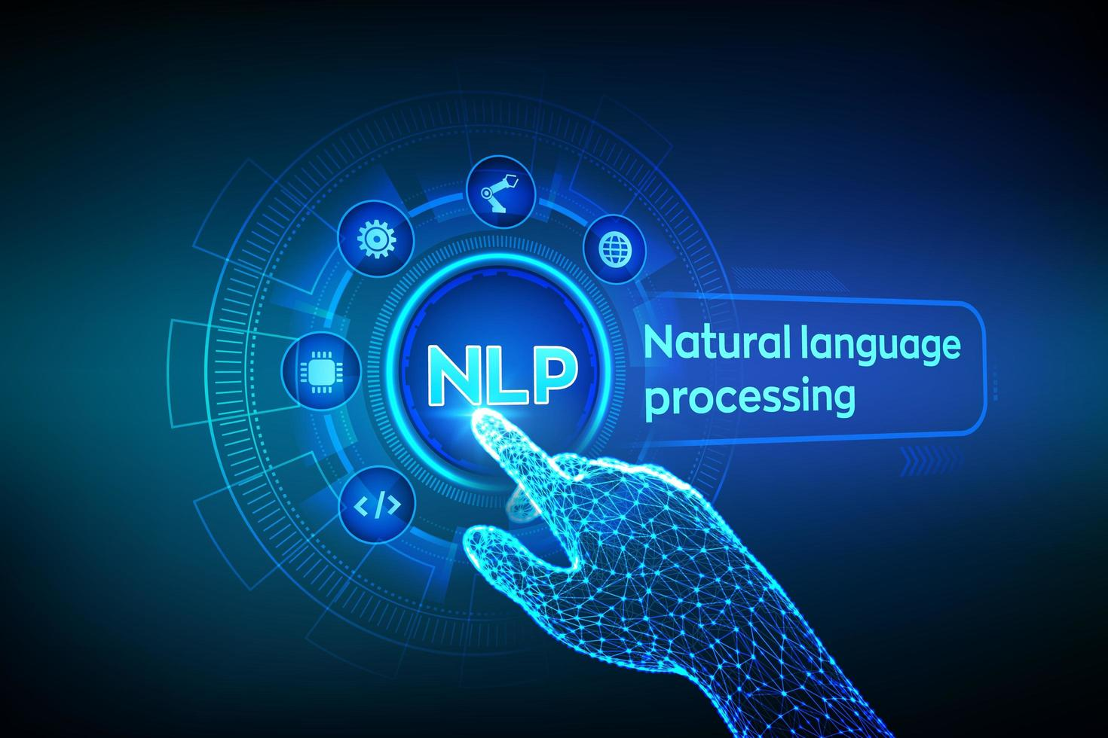
Natural Language
Processing I
Stages of Linguistic Analysis
Week 10 · Lectures 17 & 18 · NLP Fundamentals

Slide 2
Contents
01
Introduction to NLP
02
L17: Surface-Level Processing
Phonetics · Graphetics · Lexical Analysis · Morphology
03
L18: Deep-Level Processing
Semantics · Pragmatics · Discourse Analysis
04
Integration & Applications
02

Slide 3
01
Introduction to NLP
Understanding the foundations and levels of linguistic analysis

Slide 4
What is Natural Language Processing?
Definition
NLP is a branch of AI and Linguistics devoted to making computers understand human language.
Two Core Components
• NLU — Natural Language Understanding
• NLG — Natural Language Generation
Key Milestones
• 1950s — Alan Turing's foundational work
• 1960s — Chomsky's formal language theory
• 1990s+ — Probabilistic models & ML
NLU
NLG
Understanding text through linguistic analysis at multiple levels
Generating meaningful phrases, sentences, and paragraphs
"NLP caters to users who do not have enough time to learn new languages or get perfection in them."
04

Slide 5
The Seven Levels of Linguistic Analysis
# | Level | Focus | Key Tasks
1 | Phonological | Pronunciation and speech sounds | Speech recognition, phoneme identification
2 | Morphological | Word formation from morphemes | Stemming, lemmatization, POS tagging
3 | Lexical | Words and their categories | Tokenization, lexicon lookup
4 | Syntactic | Grammar and sentence structure | Parsing, grammar checking
5 | Semantic | Meaning of words and sentences | WSD, NER, semantic roles
6 | Discourse | Text structure across sentences | Anaphora resolution, coherence
7 | Pragmatic | Context and real-world intent | Speech acts, figurative language
Hierarchy from surface (sounds/writing) to deep (meaning/context) processing
05

Slide 6
From Speech to Meaning: The NLP Pipeline
Input
Phonetic/
Graphetic
Tokeni-
zation
Morpho-
logical
Lexical /
POS
Syntactic /
Parsing
Discourse /
Pragmatic
Semantic
Surface-Level Processing (L17) — Form of language
Deep-Level Processing (L18) — Meaning & context
How the Pipeline Works
• Each stage filters and enriches the representation, passing structured output to the next
• Higher levels depend on lower levels — pragmatic analysis requires semantic understanding
• Modern deep learning models implicitly learn representations across all these levels
Key Principle
• Understanding these linguistic levels is essential for designing effective NLP systems
• The pipeline is not strictly linear — higher levels can feed back to resolve ambiguities
06

Slide 7
02
L17: Surface-Level Processing
Phonetics · Graphetics · Lexical Analysis · Morphology
Lecture 17

Slide 8
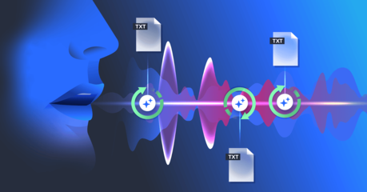
Phonetics — The Study of Speech Sounds
Definition
Phonetics studies how speech sounds are produced, transmitted, and perceived. It classifies acoustic signals into phones.
Three Branches
• Articulatory — How sounds are produced by vocal organs
• Acoustic — Physical properties of sound waves
• Auditory — How sounds are perceived by the ear
In NLP
• Essential for speech recognition systems
• Converts spoken language into text (ASR)
Example
In "loyal", the L-sounds at the beginning and end are different phones — "light L" and "dark L"
08

Slide 9
Phonology — Sound Patterns in Language
Phonemes
Allophones
Phonological Rules
The smallest units of sound that can distinguish meaning in a language.
Example: /p/ and /b/ are separate phonemes in English — "pat" vs "bat"
Variant pronunciations of the same phoneme that don't change meaning.
Example: The "p" in "pin" (aspirated) vs "spin" (unaspirated)
Systematic sound patterns that govern how phonemes combine in a language.
These rules are essential for speech synthesis and recognition systems.
09

Slide 10
Graphetics and Graphemics — Written Language Units
Graphetics
Graphemics
Study of the physical properties of written symbols — shapes, sizes, visual forms.
Analogous to phonetics but for writing. Used in OCR and handwriting recognition.
Study of how visual units (graphemes) function in writing systems.
A grapheme is the smallest unit: letters, characters, symbols.
Examples in English
• "ph" and "f" can represent the same sound but are different graphemes (phone vs fish)
• "ough" has multiple pronunciations: tough /ʌf/, through /uː/, thought /ɔː/, bough /aʊ/
• In NLP: graphetic analysis powers OCR systems that convert scanned documents to text
10

Slide 11
Lexical Analysis — Words and Their Categories
Definition
The first phase of NLP processing. Identifies words by breaking text into tokens.
Key Tasks
• Tokenization — Splitting text into words/tokens
• POS Tagging — Assigning grammatical roles
• Lexicon Lookup — Matching against dictionary
The Lexicon
• Collection of word info: categories, meanings, grammar
• Example: "pig" → Noun, Verb, Adjective
Word Category Ambiguity
Word | Category | Example
book | Noun | "the book"
book | Verb | "book a flight"
set | N/V/Adj | "a set" / "set it"
out | 5+ POS | adverb, prep, etc.
11

Slide 12
Tokenization and Part-of-Speech Tagging
Tokenization Example
POS Tagging Example
Input: "I am reading a book."
Output tokens:
["I", "am", "reading", "a", "book"]
Challenge: Multi-word expressions like "New York"
"I" → PRP (Pronoun)
"am" → VBP (Verb)
"reading" → VBG (Verb, gerund)
"a" → DT (Determiner)
"book" → NN (Noun)
Key Challenges
• Ambiguity — "book" can be noun or verb; "set" has 5+ POS categories
• Unknown words — New words, typos, domain-specific terminology
• Language-specific rules — Different tokenization for CJK languages
12

Slide 13
Morphological Analysis — Word Structure
Morphology is the study of word formation. A morpheme is the smallest unit of meaning in a language.
Inflectional Morphology
Derivational Morphology
Modifies grammatical properties without changing core meaning:
• Plural: "dog" → "dogs"
• Past tense: "walk" → "walked"
• Comparative: "tall" → "taller"
Creates new words with different meanings:
• "un-": happy → unhappy
• "-ness": happy → happiness
• "-ly": quick → quickly
Applications: Stemming reduces words to root form ("running" → "run") | Lemmatization converts to dictionary form ("better" → "good")
13

Slide 14
Types of Morphemes
Free Morphemes
Bound Morphemes
Root Morpheme
Can stand alone as words
Examples: book, run, happy
Must attach to other morphemes
Examples: un-, -ness, -s
The primary lexical unit
Example: "chatters" → root: chat
Inflectional
Derivational
Null Morpheme
Modify grammatical properties
Examples: plural -s, past -ed, comparative -er
Create new words
Examples: un-, -ness, -ly
An "invisible" affix
Example: "cat" = cat + ∅ (singular)
Understanding morpheme types is essential for stemming, lemmatization, and building morphological analyzers
14

Slide 15
Stemming vs. Lemmatization
Aspect | Stemming | Lemmatization
Method | Rule-based suffix stripping | Vocabulary + morphological analysis
Speed | Fast | Slower (requires lookup)
Accuracy | May produce non-words | Always valid words
Context | Ignores context | Considers POS and meaning
Stemming Examples
Lemmatization Examples
"running" → "run"
"flies" → "fli" (non-word)
"happily" → "happili"
"better" → "good"
"was" → "be"
"running" → "run"
15

Slide 16
L18: Deep-Level Processing
03
Semantics · Pragmatics · Discourse Analysis
Lecture 18

Slide 17
Semantic Analysis — Meaning of Words and Sentences
Definition
Focuses on understanding the meaning of words and sentences.
Two Approaches
• Syntax-driven — Derives meaning from grammar
• Semantic grammar — Uses semantic categories
Key Tasks
• Word Sense Disambiguation (WSD)
• Named Entity Recognition (NER)
• Semantic Role Labeling
Semantic Anomaly Example
Semantically Valid
"John eats an apple."
Grammatically correct + meaningful
Semantically Invalid
"Colorless green ideas sleep furiously."
Grammatically correct but meaningless
"Semantics focuses on literal meaning — pragmatics on inferred meaning"
17

Slide 18
Word Sense Disambiguation (WSD)
WSD determines the correct meaning of ambiguous words based on context. Many common words are polysemous — having multiple senses.
"bank"
"light"
"run"
• Financial institution
"I went to the bank"
• River side
"The river bank"
• Not heavy
"A light backpack"
• Not dark
"Turn on the light"
• Move quickly
"Run to school"
• Operate
"Run a program"
WSD Approaches
• Dictionary-based — Uses lexical resources like WordNet to look up possible senses
• Supervised ML — Training on manually annotated corpora with sense labels
• Unsupervised/Knowledge-based — Using co-occurrence patterns and context similarity
18

Slide 19
Named Entity Recognition (NER)
Definition
NER identifies and classifies named entities into predefined categories using lexical knowledge and contextual analysis.
Common Entity Types
Applications
• Information Extraction — Pull structured data from text
• Question Answering — Identify entities in queries
• Document Indexing — Tag entities for search
• Knowledge Graphs — Build entity relationship networks
Person
Albert Einstein
Organization
United Nations
Location
Mount Everest
Modern NER Approaches
• BiLSTM-CRF — Bidirectional LSTM with Conditional Random Field layer for sequence labeling
• BERT-based models — Fine-tuned transformer models achieve state-of-the-art accuracy
19

Slide 20
Semantic Roles and Predicate-Argument Structure
Semantic Role Labeling (SRL) identifies the roles words play relative to predicates (verbs) — revealing "who did what to whom."
Role | Description | Example
Agent | Doer of action | "Mary" gave...
Patient | Receiver of action | "book" was given
Theme | Thing acted upon | "a book"
Instrument | Tool used | "with a knife"
Beneficiary | Who benefits | "for John"
Example Analysis
"Mary gave John a book"
Mary → Agent (giver)
gave → Predicate
John → Recipient
a book → Theme (thing given)
PropBank numbering: Arg0 = Proto-Agent | Arg1 = Proto-Patient | Arg2 = Indirect Object | Applications: QA, IE, MT
20

Slide 21
Pragmatic Analysis — Context and Intent
Definition
Focuses on the intended meaning beyond literal words — considering context, tone, and speaker intention.
Key Aspects
• Intentions — Actual purpose behind statements
• Figurative meaning — Idioms, metaphors, sarcasm
• Contextual interpretation — Real-world knowledge
Core Question
"What did the speaker actually mean?"
Literal vs. Intended Meaning
Example 1
"Can you pass the salt?"
→ Request (not a question about ability)
Example 2
"Do you know what time it is?"
→ Resentment about lateness
Example 3
"I'm falling for you."
→ Expression of love (not literal falling)
21

Slide 22
Speech Acts and Figurative Language
Speech Act Classification
Assertives
Directives
Commissives
Expressives
Declarations
State facts
"The door is open"
Request action
"Close the door"
Promise/commit
"I'll help you"
Express emotion
"Thank you!"
Change reality
"I declare you married"
Figurative Language Challenges
• Idioms — "kick the bucket" = die | "break a leg" = good luck
• Metaphors — "time is money" | "the world is a stage"
• Irony/Sarcasm — Saying the opposite of what is meant
• Hyperbole — "I've told you a million times" (exaggeration)
22

Slide 23
Discourse Analysis — Beyond Single Sentences
Discourse analysis deals with how multiple sentences connect within a larger context — ensuring meaning remains coherent across text.
Anaphora Resolution
Discourse Structure
Identifying references (pronouns) and linking them to correct antecedents.
Example:
"Taylor went to the store.
She bought groceries."
→ "She" refers to "Taylor"
Identifying relationships between sentences:
• Elaboration — providing detail
• Contrast — showing difference
• Cause-Effect — explanation
• Sequence — temporal order
Unlike syntax and semantics (single-sentence), discourse operates at the text level
23

Slide 24
Anaphora and Coreference Resolution
Anaphora Resolution
Recognizes entities referenced by anaphors (pronouns).
Coreference Resolution
Finding all expressions that refer to the same entity.
Types of Anaphora
• Pronominal — "she", "it", "they"
• Definite NPs — "the door", "that man"
• Bridging — "the front door" of John's house
Resolution Example
(i) "Ram topped in the class."
(ii) "He was intelligent."
"He" refers to "Ram"
→ Coreference link established
Applications
• Document Summarization — Track entities across paragraphs | Information Extraction — Link mentions to entities
• Machine Translation — Maintain referential consistency
24

Slide 25
Discourse Structure and Coherence
Coherence Relations
Cohesion Devices
Relations that connect sentences:
• Elaboration — providing detail
• Contrast — "however", "but"
• Cause-Effect — "therefore", "so"
• Sequence — "first", "then", "finally"
Mechanisms that bind text together:
• Reference — pronouns ("he", "it")
• Substitution — "do so", "one"
• Ellipsis — omitting understood words
• Conjunction — "and", "but", "because"
• Lexical cohesion — synonyms, repetitions
Common Discourse Markers
However = contrast | Therefore = result | For example = elaboration | Moreover = addition | Although = concession | Meanwhile = temporal
25

Slide 26
04
Integration & Applications
How NLP stages combine for real-world systems

Slide 27
The Complete NLP Pipeline
Input
Text/Speech
Phonetic/
Graphetic
Tokenization
+ POS
Morphological
+ Lexical
Syntactic
Parsing
Semantic
Analysis
Discourse +
Pragmatic
L17: Surface-Level
L18: Deep-Level
How the Levels Work Together
• Each level provides an enriched representation to the next — from raw signals to structured meaning
• Lower levels handle surface structure; higher levels extract deeper meaning
Modern Deep Learning
• Transformers, BERT, GPT implicitly learn representations across all these levels
• Understanding these levels is essential for designing effective NLP systems
Key Insight
• The pipeline is not strictly linear — higher levels can feed back to resolve ambiguities
27

Slide 28
Real-World NLP Applications
Machine Translation
Chatbots & Assistants
Sentiment Analysis
Google Translate, DeepL — uses all levels from morphology to pragmatics
Siri, Alexa, ChatGPT — require pragmatic understanding for dialogue
Combines semantic and pragmatic analysis to detect opinions
Info Extraction
Text Summarization
Speech Recognition
Uses NER and semantic roles to extract structured data
Relies on discourse structure to identify key information
Begins at the phonetic level — ASR converts speech to text
Each application emphasizes different levels of linguistic analysis — understanding all stages enables building effective NLP systems
28

Slide 29
Summary & Key Takeaways
NLP processes language through seven hierarchical levels — from phonetics to pragmatics
Surface-level (L17): Phonetics, Graphetics, Lexical, Morphology — handle the form of language
Deep-level (L18): Semantics, Pragmatics, Discourse — handle meaning and context
Each level builds upon the previous, creating a pipeline from raw input to understanding
Natural Language Processing I · Week 10
Lectures 17 & 18 — Stages of Linguistic Analysis

